Slide 1
Hot Desert Climate.
Hot Deserts are found between 15 and 30 degrees North and South of the Equator.

Slide 2
Temperature.
Temperatures are high usually over 30degrees in summer.
Hot Deserts are in the Tropics, the sun shines directly over head giving high temperatures.
Night time temperatures are as low as 5 degrees.
The absence of cloud cover allows heat to escape at night.
These regions have a large daily temperature range.

Slide 3
Rainfall.
Rainfall is rare with less than 100mm per year.
There are long periods of drought (no rain) broken by sudden heavy downpours.
The hot deserts are in the path of the Trade Winds that blow overland towards the Equator.
These are dry because as they get warmer they absorb moisture.
Some deserts are in the path of winds that blow over cold ocean currents.
As they do so, they are cooled and lose their moisture over the ocean and they are dry when they hit land.

Slide 4
Vegetation. (plant life)
There is very little vegetation in the hot desert.
Plants are able to survive because they have adapted to the hot, dry conditions.
Some have long tap roots that reach into the water table; Mesquite Bush.
Others only bloom at night; Desert Dandelion.
The Cactus is the most common desert plant.

Slide 5
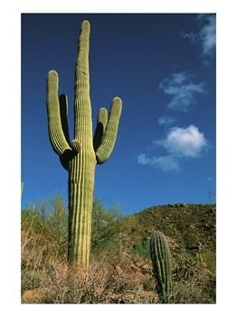
The Cactus.
It has needles to protect it from animals.
It has a thick waxy bark that prevents moisture loss.
It has a spongy interior that can absorb water.
It has shallow far reaching roots that spread out over a large area to absorb moisture.
Cactii are widely spaced to reduce competition for water.

Slide 6
Animals.
Animals that live in the desert have adapted to the harsh conditions of intense heat and lack of water.
The desert fox stays in the cool underground burrows by day and comes out in the cool of the night.
The jack rabbit has long ears to keep it cool.

Slide 7
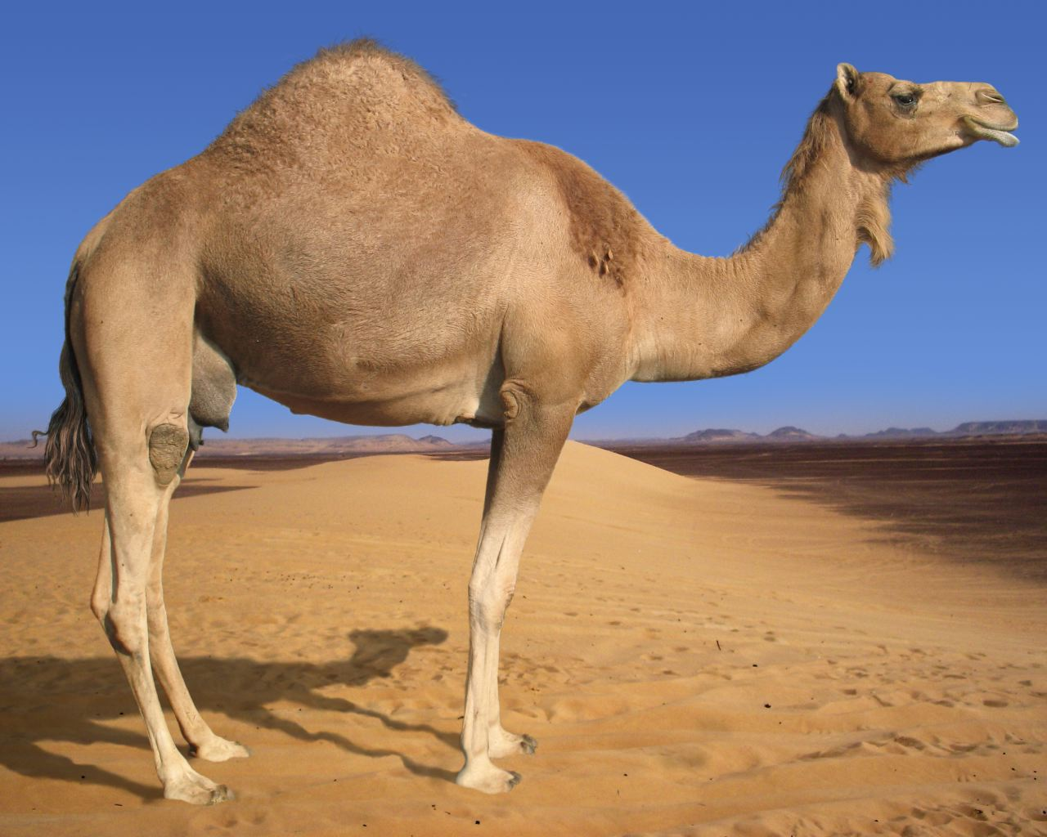
THE CAMEL
The camel has made several adaptations to the climate;
He has long eye lashes to protect his eyes from the hot sand.
He stores fat in a hump on his back for times when water and food are scarce.
He has rubbery feet to allow him walk on hot sand.
He has thick lips to allow him eat prickly plants like cactus.

